Slide 1

UNIT - 3 :DATABASE DESIGN
JAIN UNIVERSITY
SCHOOL OF COMPUTER SCIENCE AND IT
DEPARTMENT OF BCA
SUB : RDBMS
SUB CODE : 16BCA3C02

Slide 2
Functional Dependency
Functional dependency is a relationship that exists when one attribute uniquely determines another attribute.
The functional dependency is a relationship that exists between two attributes
If R is a relation with attributes X and Y, a functional dependency between the attributes is represented as
X->Y, which specifies Y is functionally dependent on X.
Here X is a determinant set and Y is a dependent attribute.

Slide 3
Example: Assume we have an employee table with attributes: Emp_Id, Emp_Name, Emp_Address.
Here Emp_Id attribute can uniquely identify the Emp_Name attribute of employee table because if we know the Emp_Id, we can tell that employee name associated with it.
Functional dependency can be written as:
Emp_Id → Emp_Name

Slide 4
Decomposition:
Decomposition is the process of breaking down in parts or elements.
It replaces a relation with a collection of smaller relations.
It breaks the table into multiple tables in a database.
It should always be lossless, because it confirms that the information in the original relation can be accurately reconstructed based on the decomposed relations.
If the relation has no proper decomposition, then it may lead to problems like loss of information.
Decomposition is used to eliminate some of the problems of bad design like anomalies, inconsistencies, and redundancy.

Slide 5
Following are the properties of Decomposition
1. Lossless Decomposition
2. Dependency Preservation
3. Lack of Data Redundancy

Slide 6
Lossless Decomposition:
Decomposition must be lossless. It means that the information should not get lost from the relation that is decomposed.
It gives a guarantee that the join will result in the same relation as it was decomposed.

Slide 7
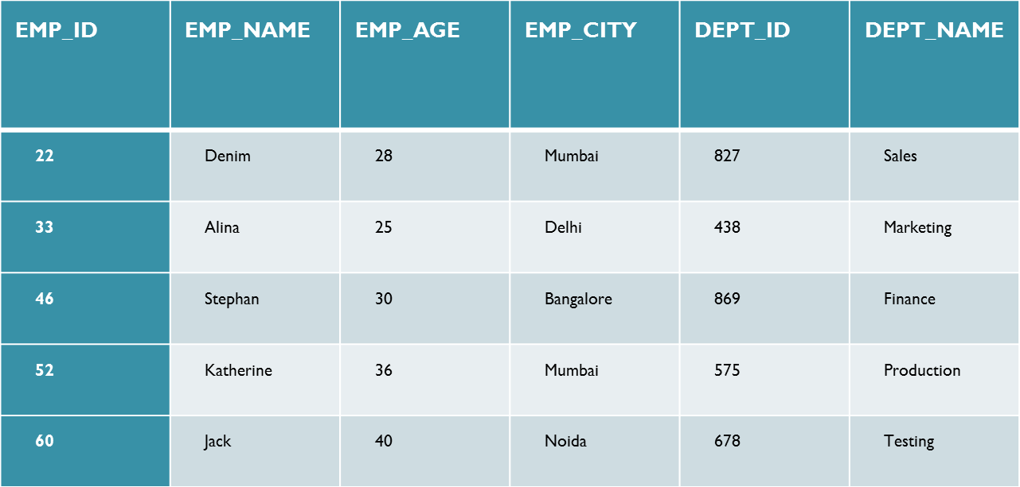

Slide 8
The above relation is decomposed into two relations EMPLOYEE and DEPARTMENT
EMP_ID | EMP_NAME | EMP_AGE | EMP_CITY
22 | Denim | 28 | Mumbai
33 | Alina | 25 | Delhi
46 | Stephan | 30 | Bangalore
52 | Katherine | 36 | Mumbai
60 | Jack | 40 | Noida
DEPT_ID | EMP_ID | DEPT_NAME
827 | 22 | Sales
438 | 33 | Marketing
869 | 46 | Finance
575 | 52 | Production
678 | 60 | Testing

Slide 9
Now, when these two relations are joined on the common column "EMP_ID", then the resultant table looks as follows
EMP_ID | EMP_NAME | EMP_AGE | EMP_CITY | DEPT_ID | DEPT_NAME
22 | Denim | 28 | Mumbai | 827 | Sales
33 | Alina | 25 | Delhi | 438 | Marketing
46 | Stephan | 30 | Bangalore | 869 | Finance
52 | Katherine | 36 | Mumbai | 575 | Production
60 | Jack | 40 | Noida | 678 | Testing

Slide 10
2. Dependency Preservation Dependency is an important constraint on the database.
Every dependency must be satisfied by at least one decomposed table.
If {A → B} holds, then two sets are functional dependent. And, it becomes more useful for checking the dependency easily if both sets in a same relation.
For example, suppose there is a relation R (A, B, C, D) with functional dependency set
(A->BC). The relational R is decomposed into R1 (ABC) and R2 (AD) which is dependency preserving because FD A->BC is a part of relation R1(ABC).

Slide 11
3. Lack of Data Redundancy Lack of Data Redundancy is also known as a Repetition of Information.
The proper decomposition should not suffer from any data redundancy.
The careless decomposition may cause a problem with the data.
The lack of data redundancy property may be achieved by Normalization process.

Slide 12
Normalization: Normalization is a database design technique which organizes tables in a manner that reduces redundancy, maintains consistency and dependency of data.
It divides larger tables to smaller tables and links them using relationships.
Normalization of data can be considered a process of analyzing the given relation schemas based on their FDs and primary keys to achieve the desirable properties of
(1) minimizing redundancy
(2) minimizing the insertion, deletion, and update anomalies

Slide 13
What is an Anomaly: A Problem that can occur in poorly unplanned, un normalized data base were all the data is stored in a one table(a flat file database)
There are three types of anomalies that occur when the database is not normalized. These are –
1. Insert
2. Update
3. Delete

Slide 14
1. An insert anomaly occurs when certain attributes cannot be inserted into the database without the presences of other attributes
2. An delete anomaly occurs when certain attributes are lost due to deletion of other attributes
3. An update anomaly exists when one or more instances of duplicated data is updated, but not all

Slide 15
Example: Suppose a manufacturing company stores the employee details in a table named employee that has four attributes: emp_id, emp_name, emp_address and emp_dept
At some point of time the table looks like this:
emp_id | emp_name | emp_address | emp_dept
101 | Rick | Delhi | D001
102 | Rick | Delhi | D002
102 | Maggie | Agra | D890
166 | Glenn | Chennai | D900
167 | Glenn | Chennai | D900

Slide 16
Update anomaly: In the above table we have two rows for employee Rick as he belongs to two departments of the company. If we want to update the address of Rick then we have to update the same in two rows or the data will become inconsistent. If somehow, the correct address gets updated in one department but not in other then as per the database, Rick would be having two different addresses, which is not correct and would lead to inconsistent data.

Slide 17
Insert anomaly: Suppose a new employee joins the company, who is under training and currently not assigned to any department then we would not be able to insert the data into the table if emp_dept field doesn’t allow nulls.

Slide 18
Delete anomaly: Suppose, if at a point of time the company closes the department D890 then deleting the rows that are having emp_dept as D890 would also delete the information of employee Maggie since she is assigned only to this department.

Slide 19
Types of Normal Forms
1.First Normal Form
2. Second Normal Form
3.Third Normal Form
4. Boyce Codd Normal Form
5. Fourth Normal form
5. Fifth Normal Form

Slide 20
First Normal Form (1NF)
A relation will be 1NF if it contains an atomic value.
It states that an attribute of a table cannot hold multiple values. It must hold only single-valued attribute.
First normal form disallows the multi-valued attribute, composite attribute, and their combinations.

Slide 21
Example: Relation EMPLOYEE is not in 1NF because of multi-valued attribute EMP_PHONE.
EMPLOYEE table:
EMP_ID | EMP_NAME | EMP_PHONE | EMP_STATE
14 | John | 7272826385, 9064738238 | UP
20 | Harry | 8574783832 | Bihar
12 | Sam | 7390372389, 8589830302 | Punjab

Slide 22
The decomposition of the EMPLOYEE table into 1NF has been shown below:
EMP_ID | EMP_NAME | EMP_PHONE | EMP_STATE
14 | John | 7272826385 | UP
14 | John | 9064738238 | UP
20 | Harry | 8574783832 | Bihar
12 | Sam | 7390372389 | Punjab
12 | Sam | 8589830302 | Punjab

Slide 23
Second normal form (2NF)
Before we learn about the second normal form, we need to understand the following −
Prime attribute − An attribute, which is a part of the primary key, is known as a prime attribute.
Non-prime attribute − An attribute, which is not a part of the prime-key, is said to be a non-prime attribute.
The second normal form says that it should be in 1NF and every non-prime attribute should be fully functionally dependent on prime key attribute

Slide 24
Example: Suppose a school wants to store the data of teachers and the subjects they teach. They create a table that looks like this: Since a teacher can teach more than one subjects, the table can have multiple rows for a same teacher.
Tacher Id | Subject | Teacher Age
111 | Maths | 38
111 | Physics | 38
222 | Biology | 38
333 | Physics | 40
333 | Chemistry | 40

Slide 25
Candidate Keys: {teacher_id, subject}
Non prime attribute: teacher_age
The table is in 1 NF because each attribute has atomic values. However, it is not in 2NF because non -key attribute teacher_age is dependent on teacher_id alone which is a proper subset of candidate key.
This violates the rule for 2NF as the rule says “non-key attributes are fully functional dependent on the primary key.”.

Slide 26
teacher_id | teacher_age
111 | 38
222 | 38
333 | 40
teacher_id | subject
111 | Maths
111 | Physics
222 | Biology
333 | Physics
333 | Chemistry
Now the tables comply with Second normal form (2NF).

Slide 27
Before studying Third Normal form (3NF) we will see about candidate key and super key

Slide 28
Super key
A super key is a group of single or multiple keys which identifies rows in a table. A Super key may have additional attributes that are not needed for unique identification.
Example:
In the below-given example, EmpSSN and EmpNum name are superkeys.
EmpSSN | EmpNum | Empname
9812345098 | AB05 | Shown
9876512345 | AB06 | Roslyn
199937890 | AB07 | James

Slide 29
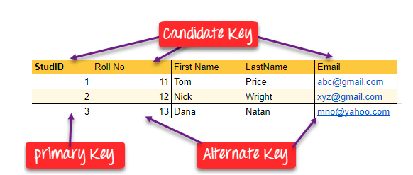
Candidate Key
A super key with no repeated attribute is called candidate key. The Primary key should be selected from the candidate keys. Every table must have at least a single candidate key.
Properties of Candidate key
It must contain unique values
Candidate key may have multiple attributes
Must not contain null values
It should contain minimum fields to ensure uniqueness
Uniquely identify each record in a table

Slide 30
Third Normal form (3NF)
A table design is said to be in 3NF if both the following conditions hold:
Table must be in 2NF
Transitive functional dependency of non-prime attribute on any super key should be removed.
An attribute that is not part of any candidate key is known as non-prime attribute.
An attribute that is a part of one of the candidate keys is known as prime attribute.

Slide 31
Example: Suppose a company wants to store the complete address of each employee, they create a table named employee_details that looks like this:
emp_id | emp_name | emp_zip | emp_state | emp_city | emp_district
1001 | John | 282005 | UP | Agra | Dayal Bagh
1002 | Ajeet | 222008 | TN | Chennai | M-City
1006 | Lora | 282007 | TN | Chennai | Urrapakkam
1101 | Lilly | 292008 | UK | Pauri | Bhagwan
1201 | Steve | 222999 | MP | Gwalior | Ratan

Slide 32
Super keys: {emp_id}, {emp_id, emp_name}, {emp_id, emp_name, emp_zip}…so on
Candidate Keys: {emp_id} Non-prime attributes: all attributes except emp_id are non-prime as they are not part of any candidate keys.
Here, emp_state, emp_city & emp_district dependent on emp_zip. And, emp_zip is dependent on emp_id that makes non-prime attributes (emp_state, emp_city & emp_district) transitively dependent on super key (emp_id). This violates the rule of 3NF.

Slide 33
To make this table complies with 3NF we have to break the table into two tables to remove the transitive dependency:
emp_id | emp_name | emp_zip
1001 | John | 282005
1002 | Ajeet | 222008
1006 | Lora | 282007
1101 | Lilly | 292008
1201 | Steve | 222999
emp_zip | emp_state | emp_city | emp_district
282005 | UP | Agra | Dayal Bagh
222008 | TN | Chennai | M-City
282007 | TN | Chennai | Urrapakkam
292008 | UK | Pauri | Bhagwan
222999 | MP | Gwalior | Ratan

Slide 34
Boyce Codd normal form (BCNF)
It is an advance version of 3NF that’s why it is also referred as 3.5NF. BCNF is stricter than 3NF.
A table complies with BCNF if it is in 3NF and for every functional dependency X->Y, X should be the super key of the table.
Example: Suppose there is a company where in employees work in more than one department. They store the data like this:

Slide 35
emp_id | emp_nationality | emp_dept | dept_type | dept_no_of_emp
1001 | Austrian | Production and planning | D001 | 200
1001 | Austrian | stores | D001 | 250
1002 | American | design and technical support | D134 | 100
1002 | American | Purchasing department | D134 | 600

Slide 36
Functional dependencies in the table above: emp_id -> emp_nationality emp_dept -> {dept_type, dept_no_of_emp}
Candidate key: {emp_id, emp_dept}
The table is not in BCNF as neither emp_id nor emp_dept alone are keys.
To make the table comply with BCNF we can break the table in three tables like this: emp_nationality table:

Slide 37
emp_id | emp_nationality
1001 | Austrian
1002 | American

Slide 38
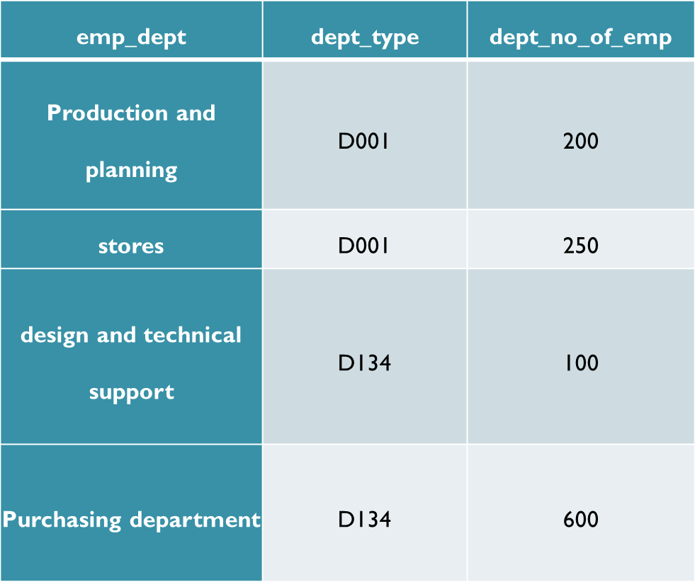

Slide 39
emp_id | emp_dept
1001 | Production and planning
1001 | stores
1002 | design and technical support
1002 | Purchasing department
Functional dependencies: emp_id -> emp_nationality emp_dept -> {dept_type, dept_no_of_emp}
Candidate keys: For first table: emp_id For second table: emp_dept For third table: {emp_id, emp_dept}

Slide 40
4th Normal Form
For a table to satisfy the Fourth Normal Form, it should satisfy the following two conditions:
It should be in the Boyce-Codd Normal Form.
And, the table should not have any Multi-valued Dependency.ie 2 independent multivalued attributes should not be dependent on same key attribute.

Slide 41
What is Multi-valued Dependency?
A table is said to have multi-valued dependency, if the following conditions are true,
For a dependency A → B, if for a single value of A, multiple value of B exists, then the table may have multi-valued dependency.

Slide 42
s_id | course | hobby
1 | Science | Cricket
1 | Maths | Hockey
2 | C# | Cricket
2 | Php | Hockey
As you can see in the table above, student with s_id 1 has opted for two courses, Science and Maths, and has two hobbies, Cricket and Hockey.
Well the two records for student with s_id 1, will give rise to two more records, as shown below, because for one student, two hobbies exists, hence along with both the courses, these hobbies should be specified.

Slide 43
s_id | course | hobby
1 | Science | Cricket
1 | Maths | Hockey
1 | Science | Hockey
1 | Maths | Cricket
And, in the table above, there is no relationship between the
Columns course and hobby.
They are independent of each other.
So there is multi-value dependency, which leads to un-necessary
repetition of data and other anomalies as well.

Slide 44
How to satisfy 4th Normal Form?
To make the above relation satisfy the 4th normal form, we can decompose the
table into 2 tables.
s_id | course
1 | Science
1 | Maths
2 | C#
2 | Php

Slide 45
s_id | hobby
1 | Cricket
1 | Hockey
2 | Cricket
2 | Hockey

Slide 46
5th Normal Form
A relation is in 5NF if it is in 4NF and not contains any join dependency and joining should be lossless (which ensures that no tuples are generated or lost, when relations are reunited through
5NF is satisfied when all the tables are broken into as many tables as possible in order to avoid redundancy.
5NF is also known as Project-join normal form (PJ/NF).
a natural join).

Slide 47
SUBJECT | LECTURER | SEMESTER
Computer | Anshika | Semester 1
Computer | John | Semester 1
Math | John | Semester 1
Math | Akash | Semester 2
Chemistry | Praveen | Semester 1

Slide 48
In the above table, John takes both Computer and Math class for Semester 1 but he doesn't take Math class for Semester 2. In this case, combination of all these fields required to identify a valid data.
Suppose we add a new Semester as Semester 3 but do not know about the subject and who will be taking that subject so we leave Lecturer and Subject as NULL. But all three columns together acts as a primary key, so we can't leave other two columns blank.
So to make the above table into 5NF, we can decompose it into three relations P1, P2 & P3:

Slide 49
P1
SEMESTER | SUBJECT
Semester 1 | Computer
Semester 1 | Math
Semester 1 | Chemistry
Semester 2 | Math

Slide 50
P2
SUBJECT | LECTURER
Computer | Anshika
Computer | John
Math | John
Math | Akash
Chemistry | Praveen

Slide 51
SEMSTER | LECTURER
Semester 1 | Anshika
Semester 1 | John
Semester 1 | John
Semester 2 | Akash
Semester 1 | Praveen

Slide 52
Example – Consider the above schema, with a case as “if a company makes a product and an agent is an agent for that company, then he always sells that product for the company”. Under these circumstances, the ACP table is shown as:
Table – ACP
AGENT | COMPANY | PRODUCT
Aman | C1 | Pen Drive
Aman | C1 | MIC
Aman | C2 | Speaker
Mohan | C1 | Speaker
The relation ACP is again decompose into 3 relations. Now, the natural Join of all the three relations will be shown as:
Table – R3
Table – R2
Table – R1
COMPANY | PRODUCT
C1 | Pen Drive
C1 | MIC
C1 | Speaker
C2 | Speaker
AGENT | PRODUCT
Aman | Pen Drive
Aman | MIC
Aman | Speaker
Mohan | Speaker
AGENT | COMPANY
Aman | C1
Aman | C2
Mohan | C2

Slide 53
Pname | Skill | Job
Aman | DBA | J1
Mohan | Tester | J2
Rohan | Programmer | J3
Sohan | Analyst | J1
R1(pname,skill)
Pname | Skill
Aman | DBA
Mohan | Tester
Rohan | Programmer
Sohan | Analyst
R2(pname,job)
Pname | Job
Aman | J1
Mohan | J2
Rohan | J3
Sohan | J1
After joining R1 natural join R2 natural join R3
Pname | Skill | Job
Aman | DBA | J1
Mohan | Tester | J2
Rohan | Programmer | J3
Sohan | Analyst | J1
R3(skill,job)
Skill | Job
DBA | J1
Tester | J2
Programmer | J3
Analyst | J1

Slide 54


